Slide 1
Sentiment Analysis with Apache Spark
Team name: Machinists
17 - Connor Larson
9 - Nathanael Goertzen
10 - Michael Homer

Slide 2
Sentiment Analysis
Sentiment analysis is the process by which we extract emotional information out of a sequence of text
Used to determine how the customers feel about a product or service
Sentiment analysis can parse through comments and apply positive or negative sentiment score

Slide 3
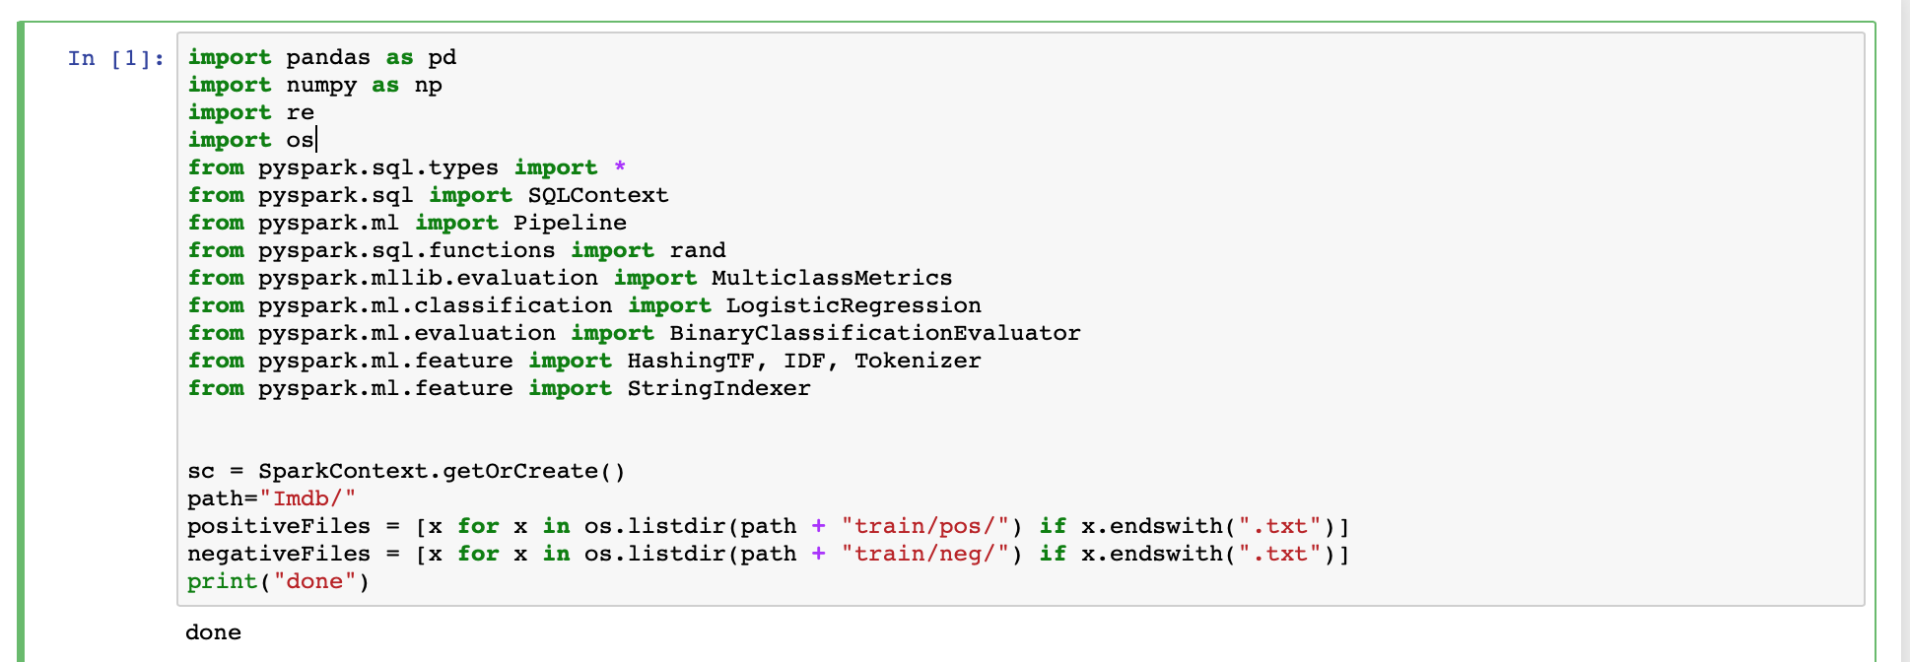
Imports and Data put in

Slide 4
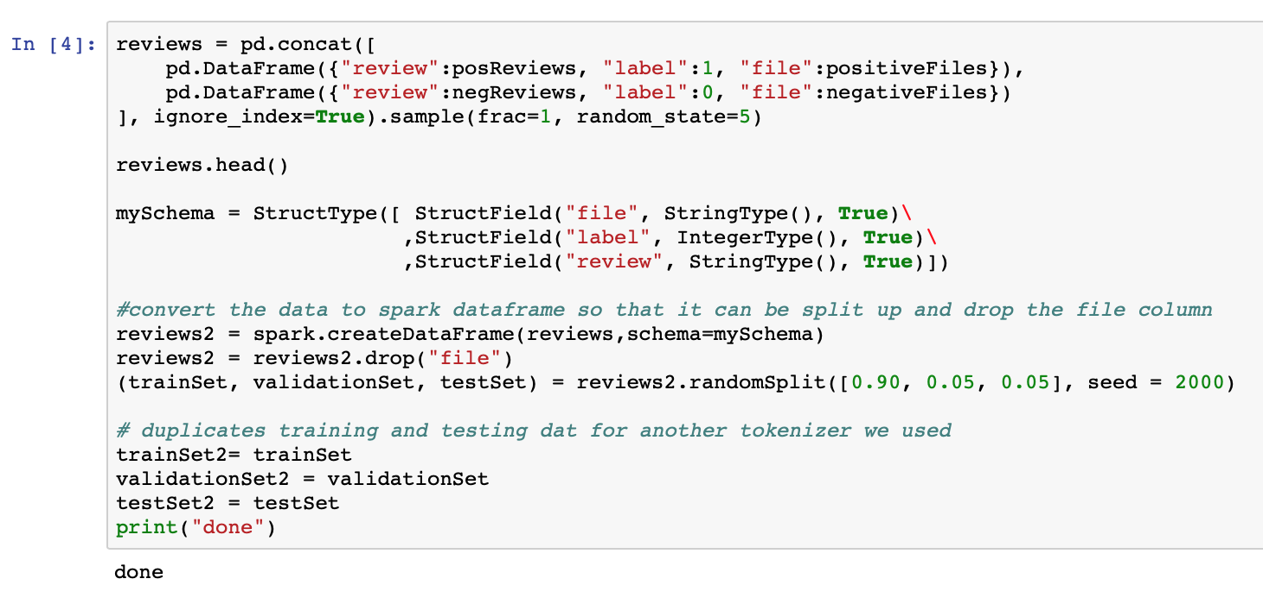
Migration to Dataframes

Slide 5
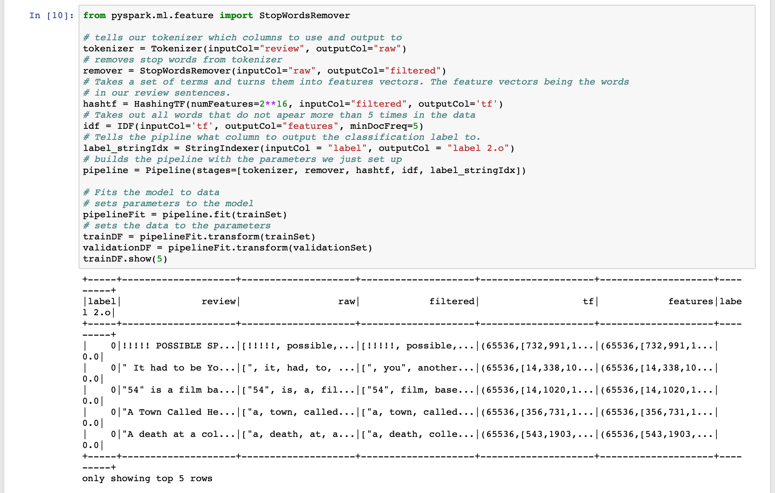
Spark Pipeline (Preprocessing)
Tokenize words in review
Filter Out stop words
(ex. “The” “a” “an” “in”)
Create Feature Vectors
Features defined by a Hash Function
Remove Words Where frequency < 5
Encode Data Labels
“Positive” => 0
“Negative” => 1
“Neutral” => 2

Slide 6
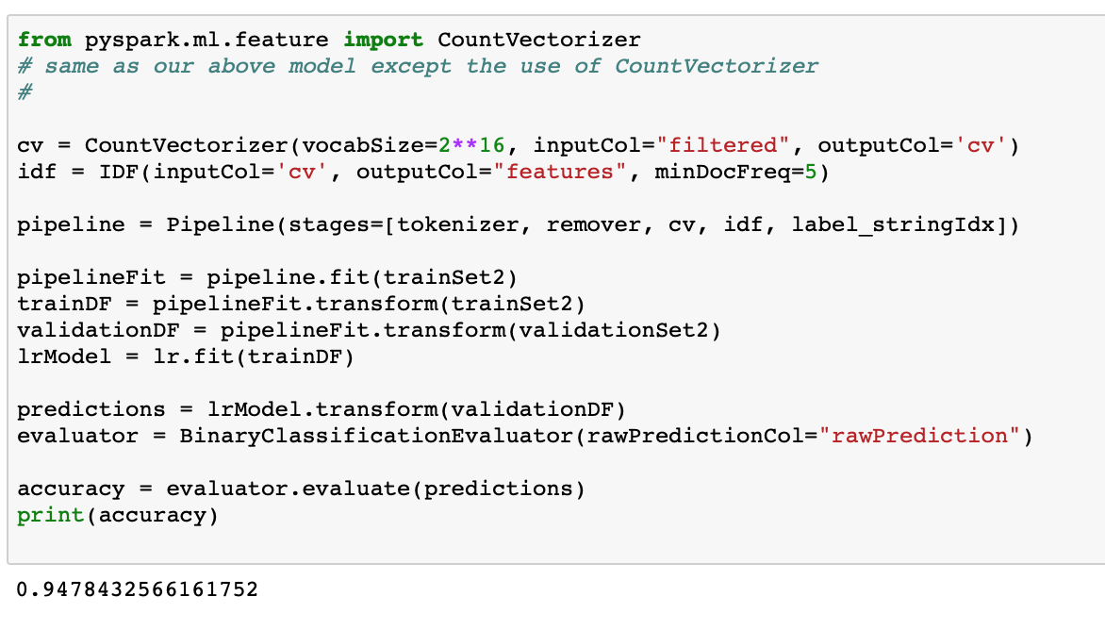
Re-attempting w/ Count Vectorizer
Maintain integrity of words in vocabulary
Counts instead of hashes
No collisions
Automatically filter by min word count (no need for IDF)
Keeping vocabulary allows for other types of preprocessing (ex: ngram analysis)
Increased accuracy

Slide 7
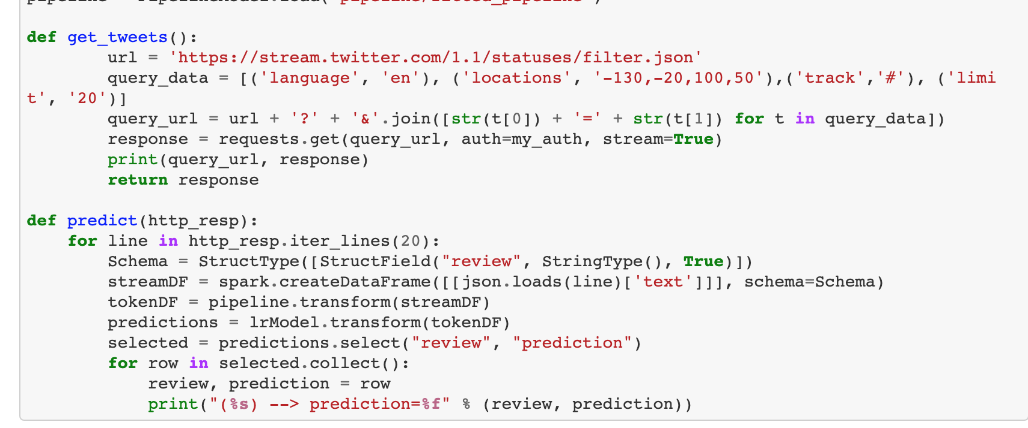
Twitter Streaming attempt
See if model can be used under a different context
Connect to a continuous stream
Test saving and reusing a model
Coerce individual streams into a dataframe
Pass through model after sending tweet dataframe through preprocessor pipeline

Slide 8
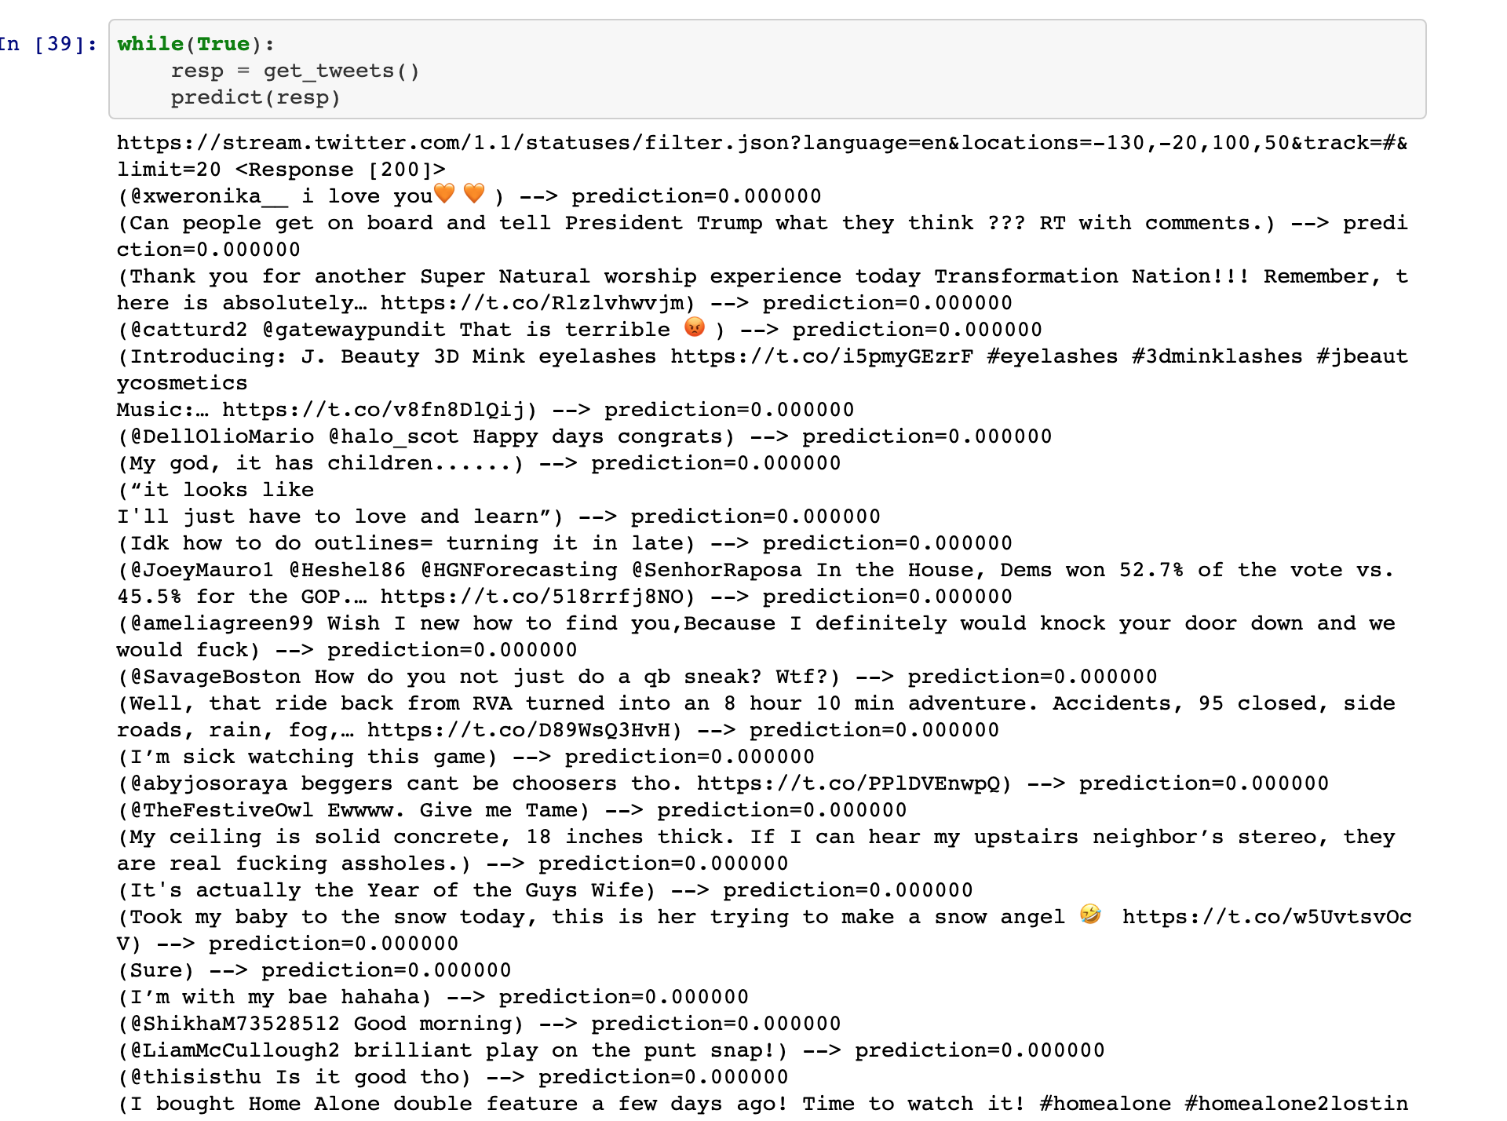
Twitter Streaming Results
Results were pretty inaccurate when compared to IMDB data
Causes:
Characters outside of UTF-8
Other Languages
Words never encountered
Tweets contain abstract language concepts (movie reviews are generally literal)
Retweet subject is in original tweet

Slide 9
Where to go from here?
It is clear that our model cannot be reused outside of movie reviews, perhaps some work should be done to make it a more general use-case analyzer.
Introduce general training, remove punctuation and other bad input

